Slide 1
BLOCKCHAIN
Proof of Work and Mining
Pr. TMIMI Mehdi

Slide 2
Main goal
Discuss :
Proof of work and mining
Bitcoin miners

Slide 3


Recall Our Naïve Consensus Protocol
=> Pick a node at random that will create a block that add transactions to the blockchain
=> Problems:
How to pick a random node?
Assumes honest nodes – easy to subvert.
Nothing at stake, no reason to be honest.

Slide 4
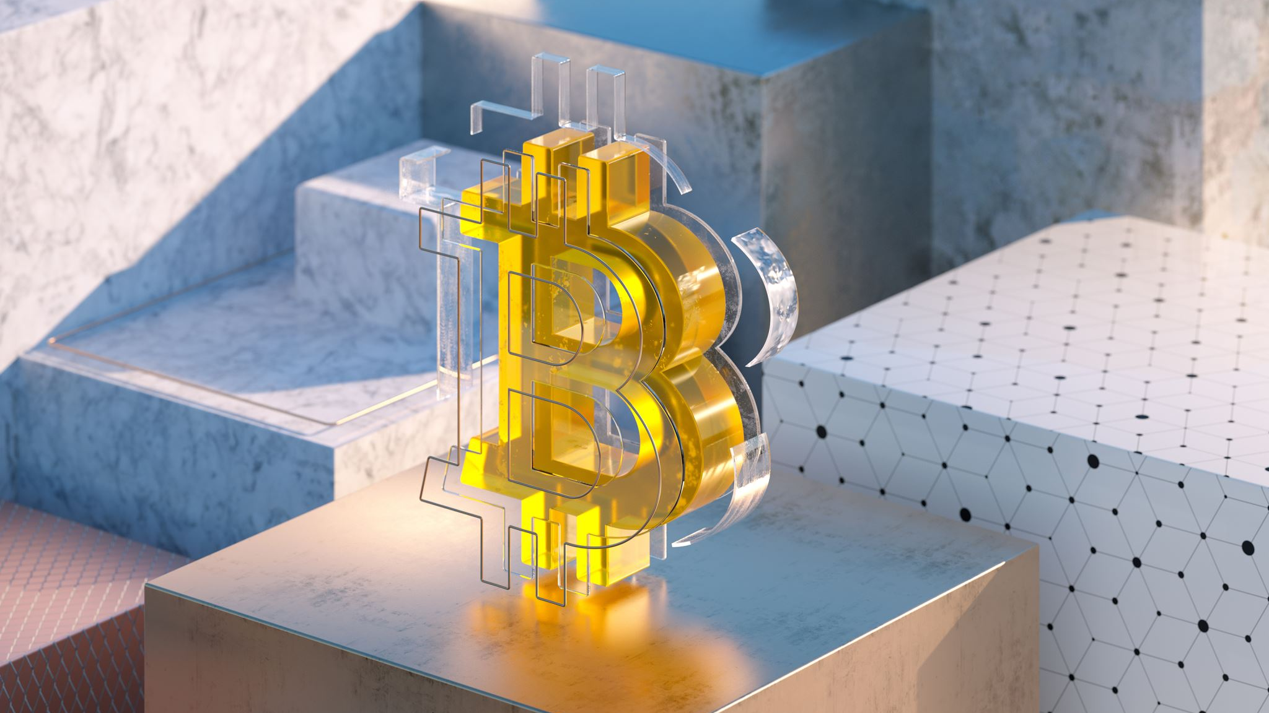
Incentives in Bitcoin
Two incentives mechanisms:
Block reward
Transaction fees

Slide 5
Block Reward
The creator of a valid block gets a reward (currently 6.25 Bitcoin).
The block reward halves every 210,000 blocks (approximately every 4 years).
Block reward is only valid if it's on long-term consensus branch, which means other nodes must accept it.
Creating block is hard work and expensive.
=> This will incentive miners to work on the long branch and be honest.
Notes:
https://bitcoinblockhalf.com/

Slide 6
The future of the Block Reward
There is no other way to generate bitcoins besides block reward.
Block rewards will reach zero (so small to be insignificant) around the 2140.
=> So... Nobody will be motivated to mine after 2140 on ?

Slide 7
Transaction Fees
The other incentive mechanism is transaction fees.
The creator of a transaction can decide to give themselves back less in 'change' than necessary.
This 'missing bitcoin' can be claimed by the miner of the block.

Slide 8
UTXOs
An unspent transaction output (UTXO) refers to a transaction output that can be used as input in a new transaction.
Address X has 4 bitcoins => Address X has a collection of UTXOs of value 4 bitcoins

Slide 9
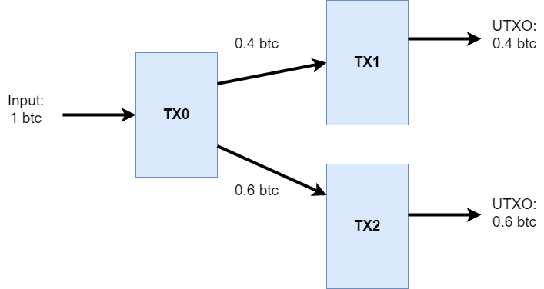
Transactions behind the scenes

Slide 10
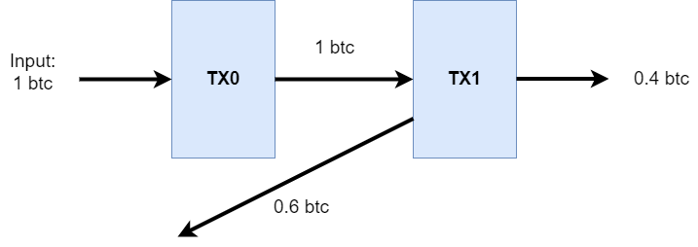
Sending 0.4 btc

Slide 11
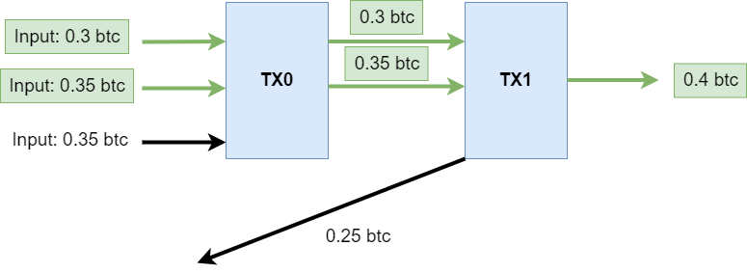
Multiples Tx Input/output

Slide 12
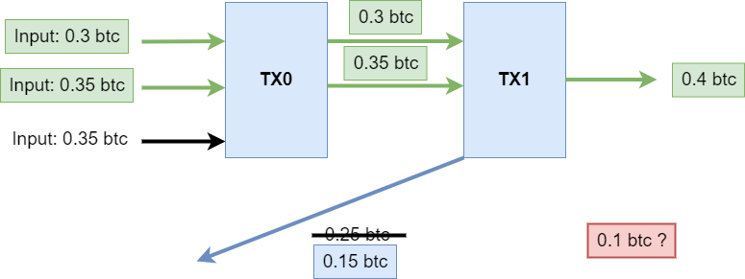
Multiples Tx Input/output

Slide 13
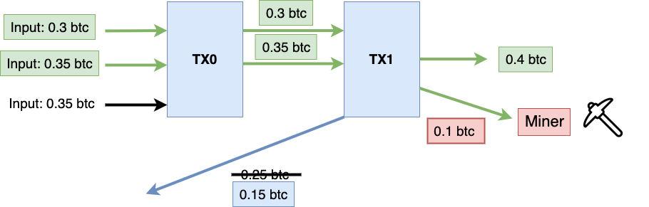
Multiples Tx Input/output

Slide 14
Transactions Fees
Miners prefer to include transactions with higher fees
Think of it as bidding for space or express mail => if you want your transaction in a block quickly, you gotta pay.

Slide 15

Proof of Work
So what's stopping you from going out there and making a block yourself and gathering the block reward and transactions fees ?

Slide 16
Transactions Fees
Miners prefer to include transactions with higher fees
Think of it as bidding for space or express mail => if you want your transaction in a block quickly, you gotta pay.

Slide 17

Provide a Valid Block
To create a block is going to require work => avoids sybil attacks (at least cheap ones)
Bitcoin uses SHA-256 hash puzzles => find a block with a nonce (number used once) such that a hash of concatenation of the nonce, the hash of the previous block and all the transactions in the block is less than some target.
=> SHA-256(nonce + prev_hash + tx₁ + tx₂ + …. + tx_{n}) < Target

Slide 18
Recall Puzzle-Friendliness of SHA-256 Hash
No solving strategy for H(nonce + x) ∈ Y better than trying different possible values of nonce (No shortcuts).
=> To find a nonce that satisfy : SHA-256(nonce + prev_hash + tx1 + tx2 + …. + txn) < Target , we are going to try a very large number of nonces

Slide 19
Hash Puzzle Properties
Difficult to compute.
Parameterizable.
Trivial to verify.

Slide 20

1- Difficult to compute
We want to prove that people worked for this
=> avoid sybil attacks / nothing-at-stake
As the creation of this slide miners are trying around 296.95 EH/s ( 1 EH/s = 1,000,000,000,000,000,000 hash per second) .
Estimation time is around 10 minutes
=> The number of attempts per second is called hash rate or hashpower.
Notes:
https://www.coinwarz.com/mining/bitcoin/hashrate-chart

Slide 21
2- Parameterizable cost
In January 9th, 2009 the hash rate was around 68 KH/s (1 KH/s = 1000 hash per second)
But blocks still were generated at a rate about one every ten minutes.
Target re-adjusts itself every 2016 blocks.

Slide 22
Impact of puzzle Friendliness
Solving hash values is probabilistic – some blocks are produced within seconds , others can take hours.
Average is 10 minutes

Slide 23
Bernoulli Trials
A Bernoulli Trial is a process with two possible outcomes (success and failure), and the probability of being successful or failure is fixed between trials.
=> examples: coin flip, roulette, dice.
Mining:
Success: Hash < target
Failure: Hash >= target

Slide 24
Poisson process
it's an Iterated Bernoulli trials.
A continuous probabilistic process where events occur independently at a constant average rate.
=> Likelihood of a block occurring follows an exponential distribution.

Slide 25
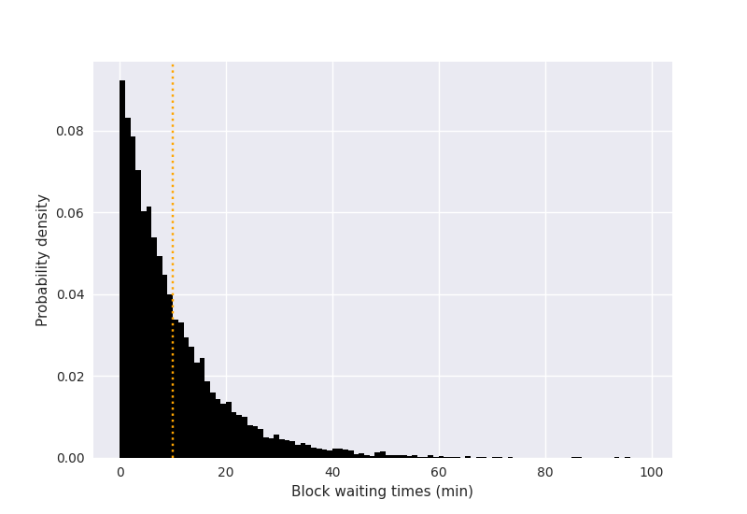
Exponential Distribution

Slide 26
Poisson process – Mining Bitcoin
Assume no nonce have been tried. => What is the mean time until we find a hash which is less than target ?
Assume 500 quintillion nonce have been tried. => What is the mean time until we find a hash which is less than target ?

Slide 27

Poisson process – Dice
I just rolled 1. => how many rolls on average until I roll 6 ?
I just rolled 4, 5, 5, 2, 1, 3. how many rolls on average until I roll 6 ?

Slide 28
How Long for a given Miner to find a block ?
I don't care about the whole network as a whole, I care about me!
Estimated time = 10 minutes / fraction of hashpower I control

Slide 29
3- Trivial to verify
It should be very difficult to mine a block, but easy for others to verify that is valid.
=> To verify:
Run SHA-256 hash function against a block with the calculated nonce
Compare with target

Slide 30

Should I mine Bitcoin?
Mining reward = block reward + transactions fees.
Mining cost = hardware cost + electricity + ….
=> if( Mining reward - Mining cost > 0 ) then YES . Else NO

Slide 31

51% Attack
Recall that the main reason of mining is decentralization.
Mining allows us to perform distributed consensus and avoid scroogeCoin-like centralization.
=> But what if more than half of the hashpower is owned by a single entity ? Is this a new Scrooge ?

Slide 32
What can this Pseudo-Scrooge Do ?
Steals coins ? NO
Surpress Transactions? YES
Change the block reward? NO
Double-Spend? YES
Hurt confidence in Bitcoin ? YES

Slide 33
In Conclusion
Scrooge could change block reward, suppress transactions without others realizing, or even change the rules of consensus.
=> none of these our pseudo-Scrooge could do.
=> Decentralized has benefits even when it's been centralized!

Slide 34
BLOCKCHAIN
Proof of Work and Mining
Pr. TMIMI Mehdi

